Slide 1
Beyond Our Borders: Trends and Arguments in Bad Faith Cases Outside Ohio in 2017 March 23, 2018 OACTA 2018 Insurance Coverage Seminar
Presented by:
John G. Farnan Daniel A. Richards

Slide 2
NEGATIVE REFERENCES TO ETHNICITY
Claim handler made negative references to the insured’s Iranian-American heritage and promptly sent his claim to a fraud investigation.
Ahmadpoor v. Truck Ins. Exchange (Cal. App., April 4, 2017), 2017 WL 1230462

Slide 3
CARRIER’S ASSERTION OF SETOFF
Applying excess provision to reduce PIP coverage under auto policy by amounts recovered from workers’ compensation carrier.
Cothran v. State Farm Mut. Auto Ins. Com (December 8, 2017), 2017 S.C. App. LEXIS 87

Slide 4
MANNER OF INVESTIGATION
Insurer:
Solicited a fraudulent report;
Utilized a forensic consulting service with the intent to mislead commercial policyholders;
Requested more documentation;
Transferred responsibility to different adjusters.
575 Wauregan Rd. v. Ohio Sec. Ins. Co.
(May 1, 2017), 2017 Conn. Super. LEXIS 2228

Slide 5
DENIAL OF COVERAGE FOR OVERLY BROAD INTERPRETATION AND APPLICATION OF EXCLUSION
Denied claim for basement flooding damage under “ground water” exclusion.
Carrier argued that “ground water” included rain water that traveled from roof into channel in a window well and from there into the basement.
Ridgewood Grp., LLC v. Millers Capital Ins. Co. (Feb. 28, 2017), 2017 Pa. Super. Unpub. LEXIS 764; 161 A. 3d 392

Slide 6
EXPOSING INSURED TO PUNITIVE DAMAGE CLAIM
Insurer failed to settle a claim, thus leaving the insured exposed to an uncovered punitive damage award.
Williamson-Green v. Interstate Fire & Cas. Co. (May 26, 2017), 2017 Mass. Super. LEXIS 70

Slide 7
POLICY VOID AB INITIO
Insured denied coverage for fire loss arguing policy was void because insured failed to disclose tax liens on the property at time of application.
Rose v. Farmers Fire Ins. Co. (July 21, 2017), 2017 Pa. Super. Upub. LEXIS 2763

Slide 8
FAILING TO PAY REPAIR CONTRACTOR’S PROFIT
Insurer “improperly excluded payments for general contractor overhead and profit from its payments to its insured’s claims.”
Sarkisvan v. Newport Insurance Company (Cal. App., January 19, 2017), 2017 WL 222048

Slide 9
IMPROPERLY CHALLENGING TOTALLY DISABLED STATUS OF A QUADRIPLEGIC
Workers compensation insurer contested claimant’s Permanently and Totally Disabled Status and by contesting petition for partial lump sum award.
Claimant was a quadriplegic.
Carrier continued to pay full weekly PTD benefits and explore settlement during pendency of action.
Iowa was willing to follow line of cases from other states holding that a claim for bad faith does not require a breach of a contract provision in the policy.
Thornton v. Am. Interstate Ins. Co. (May 19, 2017), 897 N.W.2d 445.

Slide 10
FORCING THE INSURED TO FILE SUIT
Insurer compelled the insureds to institute litigation to recover amounts due them under the policy.
Gombs v. Sentinel Ins. Co. (Superior Court of Connecticut, June 6, 2017), 2017 WL 2852695

Slide 11
FAILURE TO CONDUCT REASONABLE INVESTIGATION
Failing to conduct a reasonable investigation regarding claim value, constructively denying claim and compelling insured to bring a lawsuit.
Determination of coverage in mandatory arbitration was not res judicata on the subsequent bad faith claim.
Fortson-Kenmore v. Allstate Ins. Co. (June 15, 2017), 198 Washington App. 387; 393 P.3d 849.

Slide 12
INADEQUATE REMEDIATION
Insurer failed to ensure that all mold was properly remediated, in insured’s house, resulting in ongoing mold exposure to the insureds and additional damages.
Gombs v. Sentinel Ins. Co. (Superior Court of Connecticut, June 6, 2017), 2017 WL 2852695

Slide 13
NON-EXPERT MEDICAL JUDGMENTS
Adjustor made medical determination that insured was seeking benefits for excessive chiropractic treatment and an unrelated shoulder surgery.
Perez-Crisantos v. State Farm Fire & Cas. Co. (Feb. 2, 2017), 389 P.3d 476.

Slide 14
FAILURE TO NOTIFY INSURED OF POTENTIAL EXCESS VERDICT
Insurer failed to advise the insured of a potential excess verdict, which ended up being ten times the policy limits, and by failing to settle before case went to verdict.
Frazier v. Sain (Illinois App., September 27, 2017), 2017 Ill.App., unpub. LEXIS 1998

Slide 15
WAIVER BY FAILURE TO DELIVER ROR LETTERS
Insured had no record of ever receiving ROR letters and alleged bad faith denial and waiver of all coverage defenses due to failure to properly reserve rights.
American Safety Indemnity Co. v. Sto Corp. (June 30, 2017), 802 S.E.2d 448.

Slide 16
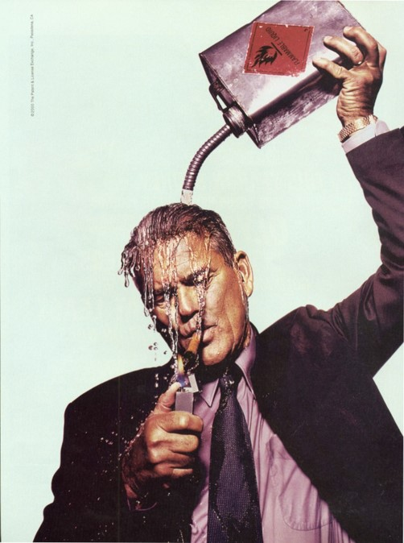
FAILURE TO INTERVIEW KEY WITNESSES
Insurer failed to contact key witnesses in the insurer’s fire investigation.
Epperson v. AAA Fire & Cas. Ins. Co. (Arizona App., January 31, 2017), 2017 Ariz. App., unpub. LEXIS 95

Slide 17
FAILURE TO TIMELY TENDER POLICY
Carrier failed to settle case within policy limits despite knowledge that claim value far exceeded policy limits.
Ellington v. Cure Auto Ins. (July 20, 2017), 2017 N.J. Super. Unpub. LEXIS 1831.

Slide 18
FAILURE TO OFFER INSURED AN INTERPRETER
Insurer failed to offer insureds an interpreter.
Preka v. Vt. Mut. Ins. Co. (December 11, 2017), 2017 Conn. Super. LEXIS 5086

Slide 19
IT’S IN THE CARDS
Carrier admitted to mistakenly limiting claim for stolen baseball cards to $1,000 cap for “coins, stamps, and collecting supplies” and took more than two years to correct mistake.
Duepner v. GEICO (June 8, 2017), 2017 Ariz. App. Unpub. LEXIS 721.

Slide 20
AUDIO-RECORDING OF EUO
Insurer allegedly acted in bad faith by making of an audiotape of EUO because it was not specifically required by the policy.
Insured conceded that a stenographer would have been okay.
N.C. Farm Bureau Mut. Ins. Co. v. Lilley (April 4, 2017), 2018 N.C. App. LEXIS 60

Slide 21
REFUSAL TO PAY UM LIMITS PRIOR TO JUDGMENT AGAINST TORTFEASOR
Failing to pay UM limits prior to the insured obtaining judgment against tortfeasor.
Manu v. GEICO (August 27, 2017), 293 Va. 371; 798 S.E.2d 598.

Slide 22
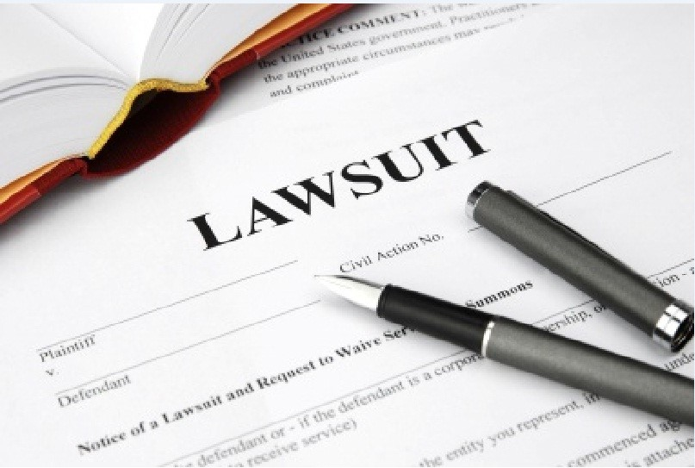
PUTTING INSURER’S INTEREST FIRST
Insurer placed its interest ahead of those of the insured forcing insureds to commence litigation.
Gerald Metals, LLC v. Certain Underwriters at International Underwriting Association of London (December 28, 2017), 2017 Conn. Super. LEXIS 5194

Slide 23
FAILURE TO DEFEND UNDER ADDITIONAL INSURED ENDORSEMENT
General Contractor alleged bad faith against subcontractor’s CGL carrier when carrier denied duty to defend GC under AI endorsement.
Pulte Home Corp. v. American Safety Indemnity Co. (Aug. 30, 2017), 14 Cal. App. 5th 1086.

Slide 24
DISCRIMINATION BASED UPON “FAMILIAL STATUS”
Insurer violated the West Virginia Human Rights Act, by engaging in discriminatory practices, by failing to competently investigate and make a reasonable settlement offer, claiming the discrimination was based on “familial status”.
Ottavino v. Durst (September 5, 2017), 2017 W. Va. LEXIS 652

Slide 25
FAILURE TO SETTLE CLAIM OF A DECEDENT’S ESTATE AGAINST INSURED
Tortfeasor sued his carrier for failing to settle death claim after insured was hit with an $8.47M verdict.
But, carrier made offer to settle for policy limits nine days after the accident.
GEICO v. Harvey (Jan. 4, 2017), 208 So.3d 810.

Slide 26
DENIAL LETTER – ALLEGEDLY DEFAMATORY
Insured claimed that denial letters that said he made false misrepresentations, as to his claim, were false and defamatory.
Withers v. Ky. Farm Bureau Mut. Ins. Co. (October 6, 2017), 2017 Ky. App., unpub. LEXIS 723.

Slide 27
CHALLENGING REASONABLENESS OF MEDICAL CARE
Carrier refused to pay portion of ER bills for L2 Trauma Center and CT Scans arguing such care was not reasonably necessary.
Falcone v. Liberty Mut. Ins. Co. (Feb. 14, 2017), 2017 OK 11; 391 P.3d 105.

Slide 28
INTERFERENCE WITH PROSPECTIVE BUSINESS RELATIONSHIPS
Insurer falsely indicated that insurer was “at fault” for the accident and disseminated this information to other carriers, causing others to only sell him insurance at much higher rates.
Withers v. Ky. Farm Bureau Mut. Ins. Co. (October 6, 2017), 2017 Ky. App. Unpub. LEXIS 723.

Slide 29
DENYING COVERAGE WHEN EFFICIENT PROXIMATE CAUSE IS COVERED
Carrier denied coverage for damages caused by release of carbon monoxide under absolute pollution exclusion when cause of the release was negligent installation of hot water tank, a covered occurrence.
Zhaoyun Xia v. ProBuilders Specialty Ins. Co. (April 27, 2017), 188 Washington 2d 171; 400 P.3d 1234.

Slide 30
CHANGE OF POLICY TERMS
Insurer’s change of policy terms, without notice and disclosure, was allegedly bad faith when insurer denied coverage based on a definition of “collapse” that had not been in her prior years’ policies.
Jemiola v. Hartford Casualty Insurance Company (March 2, 2017), 2017 Conn. Super. LEXIS 473

Slide 31
BAD FAITH CLAIM DESPITE PROVIDING DEFENSE UNDER ROR
Insured alleged bad faith against his carrier and emotional distress damages despite fact that carrier provided him a defense and settled claims filed against insured.
Carrier defended under ROR and filed DJ, alleging no coverage for migration of petroleum from vacant property.
Insured argued lack of thorough investigation and that insured disclosed the property was previously operated as a gas station.
Indiana Insurance v. Demetre (August 24, 2017), 527 S.W. 3d 12; 2017 Ky. LEXIS 364.

Slide 32
INSURER UNDERTAKING REMEDIATION
Insurer undertook a duty to complete a fuel spill clean-up, in a reasonable and timely manner, by instructing him that the insurer would handle the spill clean-up.
Burnett v. Gov’t Empls. Ins. Co. (Alaska, January 27, 2017), 389 P.3d 27

Slide 33
DELAY OF PAYMENT UNTIL AFTER INSURED PROVIDES APPRAISAL
Delaying payment for damage caused to insured’s home by sink hole until insured provided appraisal for damages which insured argued were clearly in excess of policy limits.
Landers v. State Farm (January 19, 2018), 2018 Fla. App. LEXIS 601.

Slide 34
FAILURE TO OVERSEE REPAIRS
Alleged failure to oversee the quality of repairs to his damaged yacht.
Olsen v. Std. Fire Ins. Co. (February 9, 2017), 2017 Cal. App., unpub. LEXIS 948

Slide 35
DELAYED INVESTIGATION AND PAYMENT OF CLAIM
Delayed investigation of Plaintiff’s claims and delayed settlement of Plaintiff’s lawsuit.
State ex. Rel. State Auto Prop. Ins. V. Stucky (October 10, 2017), 806 S.E. 2d 160; 2017 W.Va. LEXIS 759.

Slide 36
FAILURE TO RETURN PHONE CALLS
Not promptly returning insured’s phone calls.
Homestretch Logistical Solutions, Inc. v. Johnson Lawrence Walker Ins. Co. (February 24, 2017), 2017 Ky. App., unpub. LEXIS 155

Slide 37
UM ARBITRATION AWARD TWICE CARRIER’S OFFER
Making unreasonably low offer where subsequent arbitration award was nearly twice that amount.
Boleslavsky v. Travco Ins. Co. (Aug. 17, 2017), 2017 Phila. Ct. Com. Pl. LEXIS 257.

Slide 38
MISUSE OF RECORDED STATEMENT
The insurer took recorded statements from the insured and its employee, without any reservation of rights, but later used those statements to deny coverage.
Amco Ins. Co. v. Paul Ries & Sons, Inc. (March 14, 2017), 2017 IL App., unpub. LEXIS 492

Slide 39
CHARGING PREMIUMS FOR MULTIPLE VEHICES DESPITE KNOWLEDGE INSURED ONLY HAD ONE
Charging premiums for multi-vehicle stacked automobile coverage for 18 years, despite actual knowledge insured only had one car.
Failed to document the excess coverage on declaration pages.
Failed to provide reimbursement for overpayments despite acknowledging error.
Caputo v. State Farm (July 6, 2017), 2017 Phila. Ct. Com. Pl. LEXIS 241.

Slide 40
INAPPROPRIATE APPLICATION FOR TYPE OF BUSINESS
Denying coverage based on insured’s alleged failure to disclose a pre-policy claim because the policy application was “wholly inappropriate for the kind of business” the insured operated.
Admiral Insurance Company v. Superior Court (November 21, 2017), 18 Cal. App. 5th 383

Slide 41
FAILURE TO PAY ACTUAL CASH VALUE OF MOTOR HOME
Failing to pay actual cash value of burglarized and damaged motor home.
Dashboard was severely damaged and a replacement dashboard was no longer sold.
Carrier claimed only obligated to pay for cost of the $2000 dashboard as if it were still available as opposed to $155,000 for new motor home.
Harmon v. State Farm (May 11, 2017), 394 P.3d796; 2017 Ida. LEXIS 127.

Slide 42
INSURER’S REFUSAL TO REDUCE ITS LIEN
Window washer fell three stories to his death.
His employer’s workers’ compensation carrier paid total benefits to his widow and children of $575,000.
Estate brought claims against third parties and recovered $1.6 million.
Workers’ compensation insurer refused to reduce its lien and the estate argued that its failure to do so was bad faith.
Twin City Fire Insurance Company v. Leija (August 31, 2017), 403 P.3d 587

Slide 43
UNREASONABLE CONDUCT DURING INVESTIGATION DESPITE ULTIMATE FINDING OF NO COVERAGE
Failing to respond to insured, withholding relevant documents and referring insured’s claim to fraud unit without reasonable belief that fraud occurred.
Bad faith verdict upheld on appeal despite ultimate determination of no coverage.
Webb v. Farm Bureau Prop. & Cas. Ins. Co. (Dec. 12, 2017), 2017 Ariz App. Unpup. LEXIS 1863.

Slide 44
CLAIM HANDLER “MOCKING” THE INSURED
Claim manager allegedly “mocked” insured by accusing her of lying about part of the claim and asking whether she was “acting this way out of spite?”
Insured claimed that this caused her to become hysterical, inconsolable and to suffer a panic attack.
Smillie v. State Farm Gen. Ins. Co. (May 12, 2017), 2017 Cal. App., unpub. LEXIS 3252

Slide 45
DECISION THAT INSURED DID NOT NEED EPIDURAL STEROID INJECTIONS
Insurer decided insured did not need epidural steroid injections based upon opinion of insurer’s medical expert without further investigation despite subsequent recommendations by insured’s doctor to have them done.
Zubillaga v. Allstate (June 19, 2017), 12 Cal. App. 5th 1017.

Slide 46
EXPOSING INSURED TO EXCESS VERDICT
Failing to communicate the risk of an excess verdict, to advise the insured to seek outside counsel and to settle when the insurer should have known that the failure would expose the insured to an excess judgment.
Mason v. Liberty Mutual Insurance Company (July 18, 2017), 2017 Conn. Super. LEXIS 4019

Slide 47
DENIAL OF CLAIM OCCURRING OUTSIDE OF COVERAGE TERRITORY
Insurer denied theft claim for insureds traveling on business in Thailand where definition of coverage territory allegedly ambiguous.
Khurana v. AMCO Ins. Co. (September 29, 2017), 2017 Ida. App. Unpub. LEXIS 312.

Slide 48
INSURED TAKING THE FIFTH
Doctor in medical malpractice suit breached duty to cooperate by invoking his Fifth Amendment right.
Lemaster v. Med. Protective Ins. Servs. (July 21, 2017), 2017 Ky. App., unpub. LEXIS 534

Slide 49
INCORRECT DETERMINATION DAMAGE DID NOT EXCEED DEDUCTIBLE
Determination that wind and hail damage did not exceed insured’s deductible.
Lazos v. State Farm Lloyds (January 24, 2018), 2018 Tex. App. LEXIS.

Slide 50
FAILURE TO EXPLAIN DENIAL
Failure to provide a reasonable explanation of the “basis relied upon for the denial” of coverage.
Family Garage, Inc. v. Liberty Mutual Fire Insurance Company (October 2, 2017), 2017 Conn. Super. LEXIS 4582

Slide 51
DENIAL FOR INSUREDS REFUSAL TO GIVE A SECOND EXAM UNDER OATH
Denial of coverage when insured refused to participate in a second exam under oath.
Munoz v. State Farm (Nov. 9, 2017), 2017 Cal. App. Unpub. LEXIS 7728.

Slide 52
RELYING UPON INAPPLICABLE EXCLUSIONS
Asserting applicability of policy exclusions without sufficient evidence.
Central Amusement Int’l, LLC v. Lexington Insurance Company (October 19, 2017), 2017 K.Y. Misc., LEXIS 4023

Slide 53
FAILURE TO NOTIFY INSURED OF EXCLUSION
Insurer never told the insured about an inventory computation exclusion which, when applied, precluded coverage.
The exclusion precluded reimbursement for losses that could only be proven by taking an inventory or by profit and loss computations.
Khazai Rug Gallery, LLC v. State Auto Property & Casualty Insurance Company (March 10, 2017), 2017 Ky. App., unpub. LEXIS 187

